Slide 1

Introduction to Keil-LED,Switch
(8051 -5 Days Workshop)
DAY 7
EMBEDDED SYSTEM DESIGN & IoT-Master Class

Slide 2
What You will learn Today?
Introduction to KEIL
LED Blinking
LED and Switch Interface card

Slide 3
Mindset Lesson for the Day
More you work on yourself wider the impact will be
Exercise
Write down all of your strengths and all of your weaknesses

Slide 4
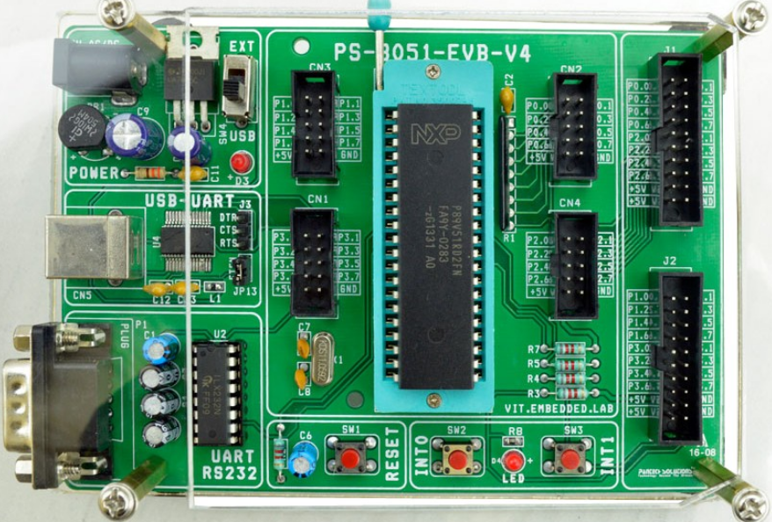

Slide 5
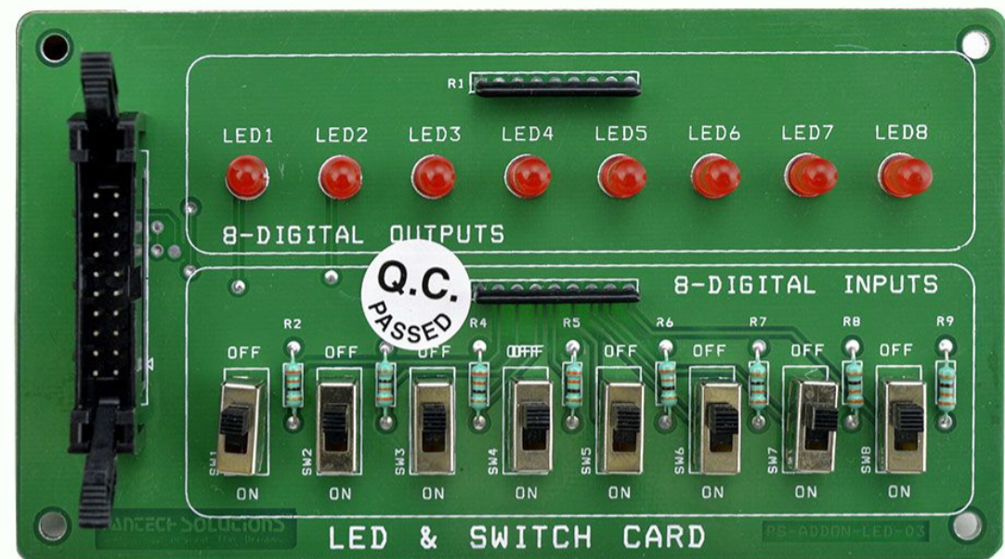
Led and Switch Interface

Slide 6
Download Keil
https://www.keil.com/download/product/
https://www.nuvoton.com/tool-and-software/software-development-tool/programmer/

Slide 7
LED INTERFACE

Slide 8
SWITCH INTERFACE

Slide 9
Blinking Led
#include <reg51.h>
#define LED P2
void delay();
void delay(void)
{
unsigned int i;
for (i=0;i<10000;i++);
}
void main()
{
LED=0x00;
delay();
LED=0xFF;
delay();
}

Slide 10
Scrolling LED
#include<reg51.h>
#define LED P2
void delay(void);
void left(void);
void right(void);
unsigned int j;
void right()
{
for (j=0x80; j>=0x01; j>>=1)
{
LED = j;
delay();
}
}
void left()
{
for (j=0x01; j<=0x80; j<<=1)
{
LED = j;
delay();
}
}
void delay(void)
{
unsigned int i;
for(i=0;i<10000;i++);
}
void main()
{
left();
right();
}

Slide 11
Switch
#include<reg51.h>
#define SW P0
#define Led P2
void main()
{
P0=0xff; P2=0x00; while(1)
{
Led = SW;
}
}

Slide 12
Thank You

